Slide 1
COVID-19 Vaccinations and Vaccine Hesitancy
Glen Nowak, PhD.
Director, Grady Center for Health and Risk Communications
Professor, Department of Advertising & Public Relations
Grady College of Journalism and Mass Communication
University of Georgia
gnowak@uga.edu
January 12, 2021 –
GA State of Public Health Conference

Slide 2
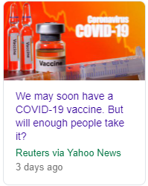
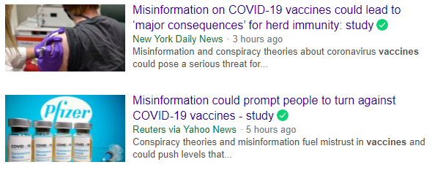
Early December 2020 news headlines

Slide 3
Important definitions
Hesitancy – as in “vaccine hesitancy” or “vaccination hesitancy”
One’s willingness or reluctance to get a recommended vaccine or vaccination
Confidence – as in “vaccine confidence” or “vaccination confidence”
One’s faith or strength of belief that receiving a recommended vaccine or vaccination will result in significant benefit(s) and very little likelihood of bad or negative outcomes (e.g., immediate reactions, adverse events)
A strong belief that the benefits of receiving a recommended vaccine or vaccination far exceeds any possible risks
Acceptance – as in “vaccine acceptance” or “vaccination acceptance”
Agreeing to receive a recommended vaccine
Getting vaccinated

Slide 4
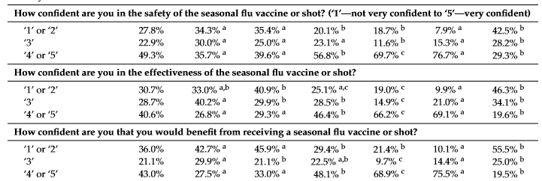
Confidence matters –
Example: Confidence in flu vaccine strongly associated with vaccination
Nowak et al., Understanding and Increasing Influenza Vaccination Acceptance: Insights from a 2016 National Survey of U.S. Adults, Int J Environ Res Public Health. 2018 Apr; 15(4): 711

Slide 5
Focus of the presentation Providing insights into the state of COVID-19 vaccine acceptance, factors that influence confidence and hesitancy, and how to approach vaccination communication and education to address hesitancy and foster acceptance.
Cover three domains:
The COVID-19 vaccination education and communication landscape
Findings from four recent surveys and reports regarding vaccination acceptance
Current and likely continued developments that affect vaccination acceptance
Seven suggestions regarding COVID-19 vaccine-related communication going forward
Five COVID-19 vaccine-related education and communication resources that you may not be aware of but may find helpful.

Slide 6
1. The COVID-19 Vaccination Communication Landscape

Slide 7
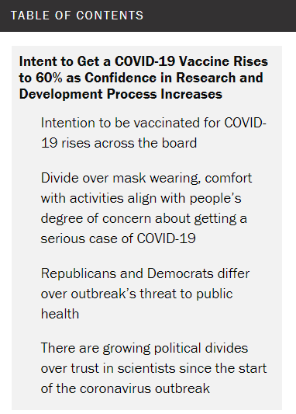
DECEMBER 3, 2020
Intent to Get a COVID-19 Vaccine Rises to 60% as Confidence in Research and Development Process Increases
Still about two-in-ten ‘pretty certain’ they won’t get vaccine – even when there’s more information
BY CARY FUNK AND ALEC TYSON,
Pew research center

Slide 8
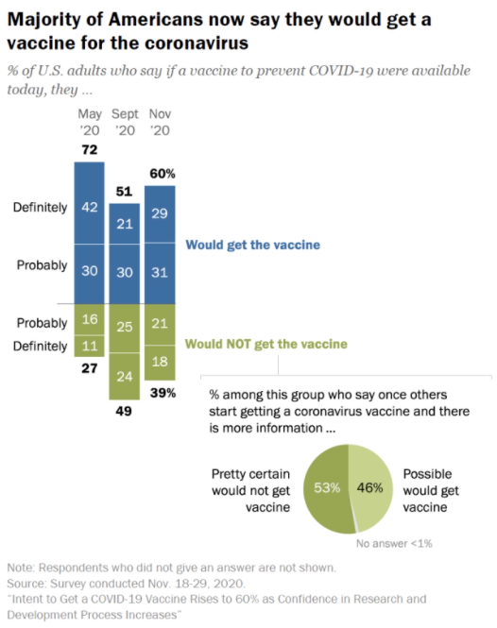

Slide 9
From the Pew Foundation report:
“The survey sheds light on the complex and interrelated factors that shape intent to get a vaccine for COVID-19, chief among them are:
Personal concern about getting a case of COVID-19 that would require hospitalization. Those most concerned about getting a serious case of the coronavirus indicate a higher likelihood of getting a vaccine. Those who see little personal need by this metric are closely divided over whether they would get vaccinated.
Trust in the vaccine development process. Expressing confidence that the research and development process will yield a safe and effective vaccine is tied to higher levels of intent to get vaccinated.
Personal practices when it comes to other vaccines. Those who say they get a flu shot yearly are much more likely than those who rarely or never do so to say they would get a vaccine for the coronavirus if one were available.
Partisanship plays a role in many of these beliefs and practices. Overall, there’s a 19-point gap between the shares of Democrats and those who lean to the Democratic Party (69%) and Republicans and Republican leaners (50%) who currently say they would get vaccinated for the coronavirus.”
https://www.pewresearch.org/science/2020/12/03/intent-to-get-a-covid-19-vaccine-rises-to-60-as-confidence-in-research-and-development-process-increases/

Slide 10
NEWS RELEASE 6-JAN-2021, Texas a&m University
Study: Black Americans, women, conservatives more hesitant to trust COVID-19 vaccine
Thirty-one percent of respondents to a Texas A&M-led survey said they don't intend to be vaccinated against COVID-19
A survey of approximately 5,000 Americans conducted in :
31.1 said they did not intend to get the COVID-19 vaccine once it becomes available to them
The two top reasons for vaccine refusal were concerns about safety and effectiveness. However, reasons for vaccine reluctance varied across sub-populations.
Likelihood of vaccine refusal was highest among Black Americans, women and conservatives
Women were 71 percent more likely to not to pursue vaccination and said they are hesitant based on safety concerns and effectiveness.
Blacks were 41 percent more likely to note pursue vaccination and said their hesitancy stemmed from similar concerns plus a lack of financial resources or health insurance.
Each one-point increase in conservatism increased the odds of vaccine refusal by 18 percent. Study noted that conservatives have been found to be generally less trusting of vaccines as well as medical and scientific professionals
The results were recently published in Social Science and Medicine.

Slide 11
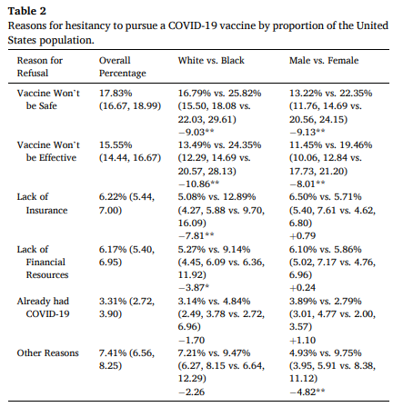

Slide 12
Vaccine Hesitancy in Rural America
Ashley Kirzinger, Cailey Muñana, and Mollyann Brodie, Published January 7, 2020
https://www.kff.org/coronavirus-covid-19/poll-finding/vaccine-hesitancy-in-rural-america/
Kaiser Family Foundation Health Tracking Poll/ KFF COVID-19 Vaccine Monitor.
The survey conducted November 30- December 8, 2020, among a nationally representative random digit dial telephone sample of 1,676 adults ages 18 and older (including interviews from 298 Hispanic adults and 390 non-Hispanic Black adults), living in the United States, including Alaska and Hawaii.
The margin of sampling error including the design effect for the full sample is plus or minus 3 percentage points.
The KFF COVID-19 Vaccine Monitor is an ongoing research project tracking the public’s attitudes and experiences with COVID-19 vaccinations. Using a combination of surveys and focus groups, this project tracks the dynamic nature of public opinion as vaccine development unfolds, including vaccine confidence and hesitancy, trusted messengers and messages, as well as the public’s experiences with vaccination as distribution begins.

Slide 13
Key findings summary. . .
“MORE THAN A THIRD OF rural residents are hesitant to get a COVID-19 vaccine, survey results show, placing them alongside Republicans and Black adults as among the groups most wary of getting vaccinated.”
“According to the Kaiser Family Foundation's COVID-19 Vaccine Monitor project, survey results show that 15% of rural residents said they would "probably not get" a safe and free vaccine if available and 20% would "definitely not get it." Only about 3 in 10 rural residents said they would "definitely get it" compared with about 4 in 10 people in both urban and suburban areas.”
“By comparison, the survey also reportedly found that 42% of Republicans, 36% of adults ages 30 to 49 and 35% of Black adults said they would probably not or definitely not get the vaccine, compared with 26% of white adults, 15% of those 65 and older, and 12% of Democrats.”
https://www.usnews.com/news/health-news/articles/2021-01-07/covid-vaccine-hesitancy-highest-in-rural-america-survey-shows

Slide 14
When results were controlled for factors such as political affiliation, hesitancy was still higher among rural residents than their urban and suburban counterparts.
According to the KFF analysis, the survey showed that half of rural residents said the seriousness of the coronavirus has been "generally exaggerated" in the news, compared with 27% of urban residents and 37% of suburbanites.
Additionally, 62% of rural residents said they see getting a vaccine as a personal choice, compared with 36% who said it's "part of everyone's responsibility to protect the health of others." Among urban and suburban residents, 55% and 47% shared the same view of getting a vaccine as a social responsibility, respectively.
For rural Americans, those trusted messengers include their health care provider. A large majority – 86% – said they trust their own doctors or providers to provide reliable information on the vaccine. Meanwhile, 68% said they trust the Food and Drug Administration, while 66% said they trust the Centers for Disease Control and Prevention, 64% trust their local health department, 59% trust government expert Dr. Anthony Fauci and 55% said they trust their state government.”
https://www.usnews.com/news/health-news/articles/2021-01-07/covid-vaccine-hesitancy-highest-in-rural-america-survey-shows

Slide 15
Despite having intimate knowledge of the pain and death caused by the coronavirus, a surprising number of US healthcare workers are refusing to get a COVID-19 vaccine, Joshua Zitser, Business Insider, January 10, 2021
A large number of healthcare workers in US nursing homes and hospitals are refusing to get vaccinated against COVID-19. As much as 80% are turning down a shot in some institutions, according to AP.
In a number of states, officials have raised the alarm about the low take-up rate of vaccines among healthcare workers.
Vaccine skepticism is higher than average among those working in a healthcare setting. Three in ten say they are hesitant to get vaccinated, according to a Kaiser Family Foundation study.
Ohio Gov. Mike DeWine has had to warn frontline staff that if they want a vaccine any time soon, they must act now.
In recent days, the US has broken records for both the highest daily rise in new COVID-19 cases and for the highest daily death toll.

Slide 16
The COVID-19 Vaccine Communication landscape also includes much that affects vaccination confidence, hesitancy, and acceptance. . .
'Like watching a train wreck’:
Experts say America is behind on COVID-19 vaccine messaging, call for honest, straight talk
Elizabeth Weise, USA TODAY, November 10, 2020
The U.S. government has spent more than $10 billion creating vaccines to protect against COVID-19 but so far little encouraging Americans to take them.
Public health officials say that's a mistake.
“This needed to happen yesterday. It’s like watching a train wreck happen,” said Daniel Salmon, director of the Institute for Vaccine Safety at Johns Hopkins Bloomberg School of Public Health.
Now, even before any vaccines are approved, is the time to start telling America straight-up what to expect, more than a dozen public health and medical experts told USA TODAY.

Slide 17
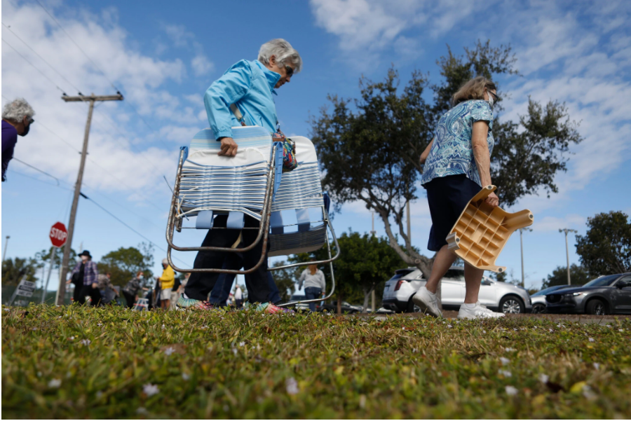
‘It Became Sort of Lawless’: Florida Vaccine Rollout Turns Into a Free-for-All
Florida decided people 65 and older should get the coronavirus vaccine first. But demand has overwhelmed supply, and people are frustrated.
By Patricia Mazzei, Eric Adelson and Kate Kelly, The New York Times, Jan. 10, 2021
MIAMI — Linda Kleindienst Bruns registered for a coronavirus vaccine in late December, on the first day the health department in Tallahassee, Fla., opened for applications for people her age. Despite being 72, with her immune system suppressed by medication that keeps her breast cancer in remission, she spent days waiting to hear back about an appointment.
“It’s so disorganized,” she said. “I was hoping the system would be set up so there would be some sort of logic to it.”
Phyllis Humphreys, 76, waited with her husband last week in a line of cars in Clermont, west of Orlando, that spilled onto Highway 27. They had scrambled into their car and driven 22 miles after receiving an automated text message saying vaccine doses were available. But by 9:43 a.m., the site had reached capacity and the Humphreys went home with no shots.
“We’re talking about vaccinations,” said Ms. Humphreys, a retired critical care nurse. “We are not talking about putting people in Desert Storm.”
Well prepared for a long wait, people queued up to receive a Covid-19 vaccine at the Fort Myers Stars Complex in Fort Myers, Fla., last week. Credit: Octavio Jones for The New York Times

Slide 18
U.S. Covid-19 Vaccination Plan Limits Speed of Rollout, Supply-Chain Experts Say
The decentralized effort focuses on supply with less attention to the last mile, or getting the ‘vaccine from storage into people’s arms’, Jennifer Smith, The Wall Street Journal, January 10, 2021
A sluggish rollout of Covid-19 vaccines across the U.S. highlights the challenges of a decentralized distribution plan that relies on states and localities to handle the complicated last-mile logistics of getting shots into people’s arms, supply-chain experts say.
More than 22 million doses had been distributed to states and other jurisdictions as of Friday, according to the Centers for Disease Control and Prevention, while 6.7 million people had received their first shot by that point. The figures were short of the U.S. goal of 20 million vaccinations by the end of 2020, and communities and states were still reporting bottlenecks this month as they managed their inoculation programs.
“If you told states your priority is to vaccinate as many people as possible as fast as they can, they would have run the campaign differently,” said Julie Swann, a professor and head of the industrial and systems engineering department at North Carolina State University. “But that’s not what they were told.”
Instead of seeking to halt the spread of transmission in communities, said Dr. Swann, who advised the CDC during the H1N1 pandemic, the focus has been on reducing mortality, especially among high-risk populations.

Slide 19
COVID-19 vaccine safety-related news, questions, and concerns, including. . .

Slide 20
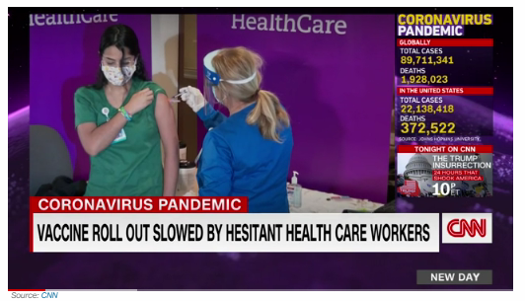
(CNN) In some hospitals, health centers and pharmacies in the United States, there are vials of Covid-19 vaccines that aren't making it into arms.
Out of the more than 22 million doses of vaccine that have been distributed to hospitals and pharmacies so far in the United States, only about 6.7 million people have received their first dose, according to data from the US Centers for Disease Control and Prevention.
There's no one reason for the slow rollout or doses going unused; experts say it was never going to be easy to begin a mass vaccination campaign during a pandemic. It takes time to vaccinate and monitor large numbers of people, and some facilities are staggering staff vaccinations to avoid having too many health care workers out at once.

Slide 21
Biden Plans to Release Nearly All Available Covid-19 Vaccine Doses
Administration would shift from current strategy of holding half of supply for booster shots as U.S struggles to ramp up program,
By Sabrina Siddiqui and Stephanie Armour, The Wall Street Journal, Jan. 8, 2021
President-elect Joe Biden will seek to release nearly all available coronavirus vaccine doses to accelerate distribution, his transition team said Friday, in a shift from the Trump administration’s policy of holding back stock for second doses.
“The president-elect believes we must accelerate distribution of the vaccine while continuing to ensure the Americans who need it most get it as soon as possible,” said TJ Ducklo, a spokesman for Mr. Biden’s transition. “He supports releasing available doses immediately, and believes the government should stop holding back vaccine supply so we can get more shots in Americans’ arms now.”
Mr. Ducklo said Mr. Biden, who will be inaugurated on Jan. 20, will release additional details about his vaccine distribution plans next week. They include establishing federally run vaccination sites, as well as mobile units that can travel to rural and underserved areas, and the launch of a national public awareness campaign around vaccine safety and guidelines, said incoming White House press secretary Jen Psaki.

Slide 22
3. Thoughts and suggestions regarding
COVID-19 vaccine-related communication going forward

Slide 23
One, it is important we recognize that the COVID-19 vaccination communication and education landscape will be more challenging than many currently realize.
The many uncertainties regarding initial COVID-19 vaccines – especially safety, effectiveness, duration of protection, overall availability, local availability, and demand
Trust, credibility, and health information-seeking strongly connected with moral values and political beliefs
Wide variations in COVID-19 disease effects/impact and individual perceptions and beliefs regarding the COVID-19 health threat
Two-dose non-interchangeable vaccines, differences in federal and state priority groups, and different approaches to scaling vaccination
Likelihood of multiple non-interchangeable vaccines being available, each having different requirements and safety and efficacy profiles
A more complex and dynamic vaccine and vaccination communication and education environment that we have previously experienced and that involves major changes in U.S. vaccination system

Slide 24
Recognize that COVID-19 vaccine realities matter – they do and will affect benefit-risk beliefs, confidence, hesitancy, and acceptance
People’s perceptions and beliefs regarding those realities are also often associated with vaccine confidence, hesitancy, and acceptance
Perception that one is susceptible to becoming infected (e.g., with COVID-19) and likely to experience severe illness.
Belief that the processes, entities and people involved in the vaccine development, assessment, and recommendations are credible and can be trusted
Belief that the outcomes and benefits from getting a COVID-19 vaccination – such as protection from symptoms and serious illness – are significant (e.g., protect one from hospitalization and death) and outweigh any vaccine risks.
Belief that becoming immunized is worth taking the steps involved in the vaccination process.

Slide 25
Know the goal(s) or objective(s) of your communication efforts and messages. What does success look like?
Inform? Is it your ultimate intent to just provide information about COVID-19 vaccines and vaccination?
Educate? Is it your ultimate intent to provide information that will increase the recipient’s knowledge and understanding of COVID-19 vaccines (e.g., how they work) and vaccination (e.g., here’s how they protect you from illness).
Build confidence? It is your ultimate intention to provide information and insights that will increase trust in COVID-19 vaccines and vaccination?
Persuade? Is it your ultimate intent to convince those who are hesitant to get vaccinated?

Slide 26
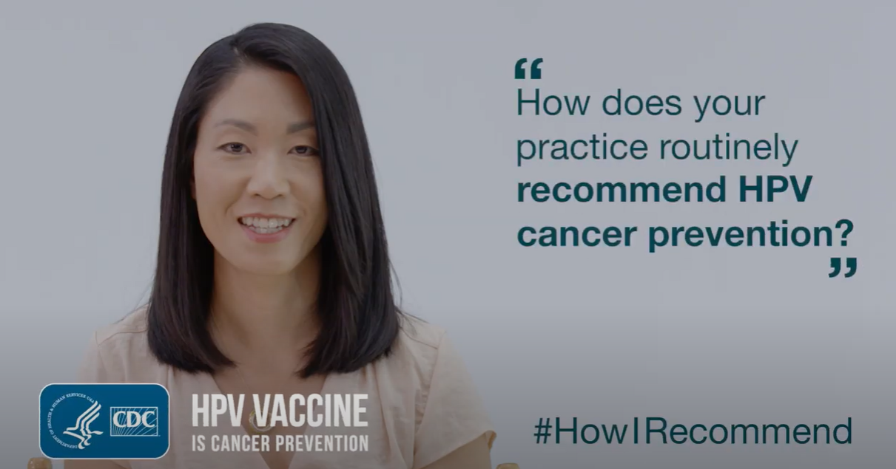
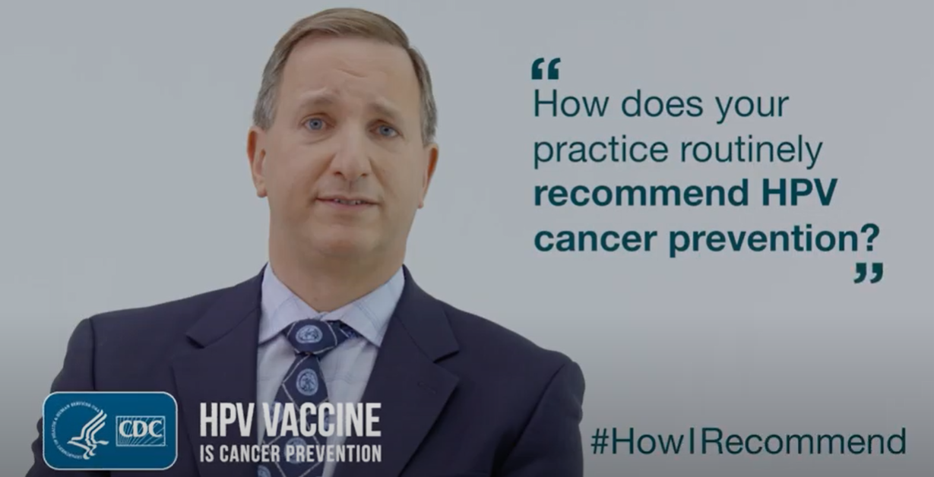
Use core risk and health communication principles
Tailor messages to patient concerns, questions, life situation
Express empathy and understanding
Guide expectations
Highlight individual benefits associated with a recommendation
Acknowledge individual risks with a recommendation
Use words and language that are understandable and culturally appropriate – and it helps when you define key words and ideas, even when you may not think it necessary (e.g., safe, effectiveness, side effects, adverse event, protection from illness vs. protection from infection)
Provide helpful framing and context
Acknowledge uncertainties - as well as the value or need to take actions in the face of uncertainties
Foreshadow possibilities and potential outcomes

Slide 27
Helpful framing and context
Data from early trials of several Covid-19 vaccines suggest that consumers will need to be prepared for side effects that, while technically mild, could disrupt daily life. A senior Pfizer executive told the news outlet Stat that side effects from the company's vaccine appear to be comparable to those of standard adult vaccines but worse than those of the company's pneumonia vaccine, Prevnar, or typical flu shots.
The two-dose Shingrix vaccine, for instance, which protects older adults against the virus that causes painful shingles, results in sore arms in 78 percent of recipients and muscle pain and fatigue in more than 40 percent of those who take it. Prevnar and common flu shots can cause injection-site pain, aches and fever.
Foreshadowing possibilities
Helpful context, Guide expectations

Slide 28
Helpful framing
How public health experts explain such effects is important, Omer said. "There's evidence that suggests that if you frame pain as a proxy of effectiveness, it's helpful," he said. "If it's hurting a little, it's working.“
At the same time, good communication will help consumers plan for such effects. A Covid-19 vaccine is expected to be distributed first to health care staffers and other essential workers, who may not be able to work if they feel sick, said Dr. Eli Perencevich, a professor of internal medicine and epidemiology at University of Iowa Health Care.
"A lot of folks don't have sick leave. A lot of our essential workers don't have health insurance," he said, suggesting that essential workers should be granted three days of paid leave after they're vaccinated. "These are the things a well-functioning government should provide for to get our economy going again."
Tailor to patient’s lifesituation
Address and remove barriers / provide incentives

Slide 29
Draw upon what we’ve learned from influenza vaccination hesitancy and declination; similar beliefs are happening with COVID-19 vaccination, including. . .
Perceiving or believing COVID-19 is a “manageable” illness and/or severe illness from influenza is very unlikely – including as a result of personal experience with COVID-19.
Not knowing or believing that COVID-19 vaccination recommendations apply to people like them or that they needed protection from COVID-19.
Believing other measures are equally or more effective than COVID-19 vaccination (e.g., one’s lifestyle, hand washing, diet, vitamins, avoiding people who are sick).
Perceiving or believing that COVID-19 vaccines are not very effective – and/or that unless duration protection is long, they are not worth getting
Believing that COVID-19 vaccination would cause undesired effects

Slide 30
Look for, develop, utilize, and make visible COVID-19 vaccine and vaccination communication resources and advice/examples

Slide 31
Remember, COVID-19 vaccine information will be evolving and changing in the weeks and months ahead.
The best communication can occur once full data from the Pfizer trial and others are presented, said Dr. Paul Offit, a vaccinologist at Children's Hospital of Philadelphia who sits on the Food and Drug Administration's advisory board considering Covid-19 vaccines.
"When you look at those data, you can more accurately define what groups of people are most likely to have side effects, what the efficacy is, what we know about how long the efficacy lasts, what we know about how long the safety data have been tested," he said. "I think you have to get ready to communicate that. You can start getting ready now."

Slide 32
In sum:
Reducing vaccination hesitancy, building vaccine confidence and achieving high vaccination rates, particularly for COVID-19 vaccines is more likely to happen when. . .

Slide 33
Healthcare providers are confident in the safety, effectiveness, and benefits of COVID-19 vaccines – and can effectively convey that to patients and the public.
Those involved in COVID-19 vaccination education and advocacy:
Acknowledge and address concerns and reluctance
Create high COVID-19 vaccine and vaccination recommendation understanding among public health programs, healthcare providers, and immunization coalitions
Have and set realistic expectations regarding COVID-19 vaccines and COVID-19 vaccination recommendations, e.g.,
Steadily building confidence and acceptance over time vs. trying to achieve immediate high across-the-board demand
Tempering expectations regarding whether and how fast community immunity can be achieved with new vaccines
Place priority on building trust and confidence through open, continuous, frank, and responsive communication on vaccine effectiveness, safety, and benefits

Slide 34
Four COVID-19 vaccine-related education and communication resources that you may not be aware of but may find helpful for addressing hesitancy concerns, building confidence, and fostering vaccination.

Slide 35
The Ad Council’s COVID-19 Vaccination Efforts and Resources https://www.adcouncil.org/campaign/coronavirus-prevention
Eighteen Leading Health Organizations and Dr. Anthony Fauci partner with the Ad Council and the COVID Collaborative to Help Healthcare Providers Better Understand and Answer Common Questions about COVID-19 Vaccination. Dec. 29, 2020 https://www.youtube.com/playlist?list=PLdSSKSOSBh4mcQbLK0NnLo8iP5TNqUCOf&webSyncID=e3645ca4-0b27-a645-ed37-1d9521ec5b9c&sessionGUID=888bb326-4347-d77b-d374-bd812c62b358
The Ad Council is designing and implementing a $50 million campaign to help foster COVID-19 vaccination. Lisa Sherman, president and CEO of the Ad Council said the campaign will be widely targeted with a "unified and consistent message" going beyond television to include modern technology platforms. The campaign will:
Provide healthcare providers information to share with patients who may be skeptical of the vaccine;
Create national public service announcements encouraging COVID vaccinations;
Work to specifically reach "communities of color that have been the hardest hit by the pandemic and where we see higher levels of hesitancy.“

Slide 36
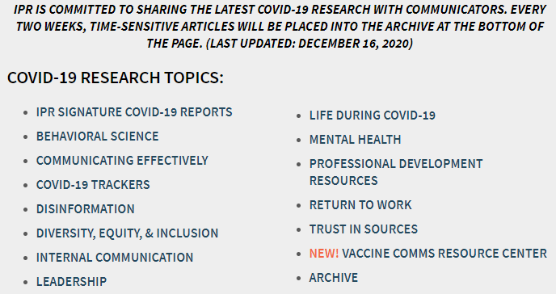
https://instituteforpr.org/covid-19-resources-for-pr-professionals/

Slide 37
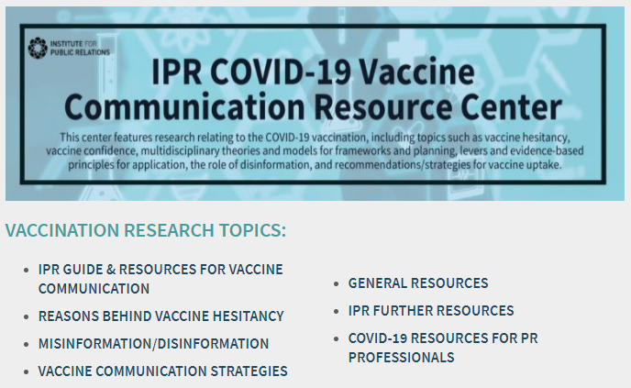

Slide 38
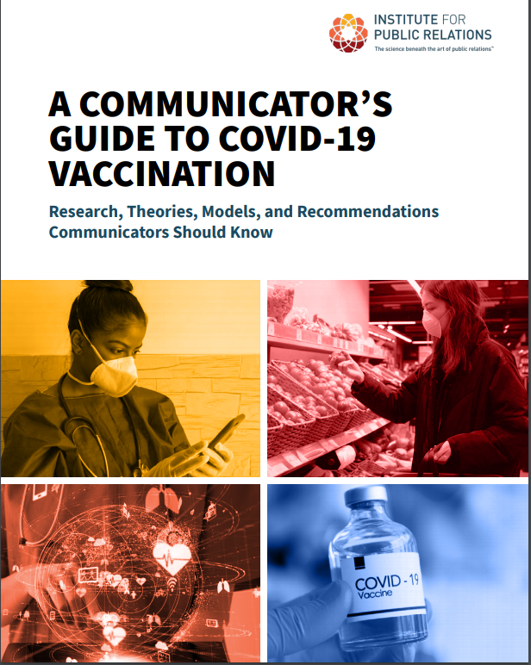
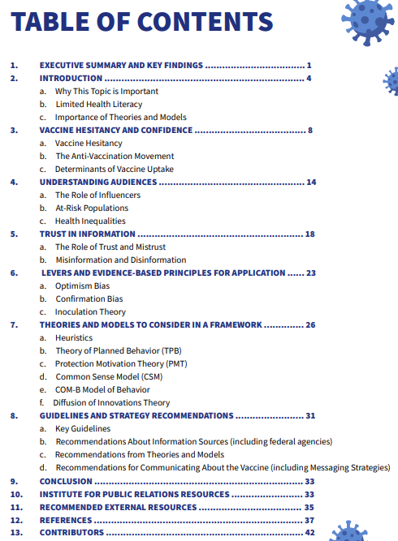

Slide 39
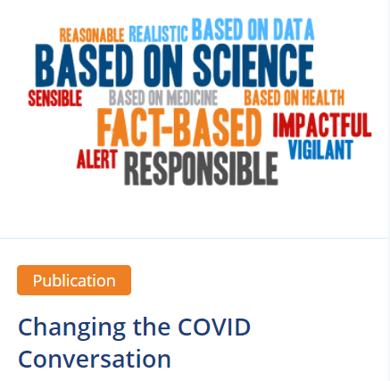
The de Beaumont Foundation
whose mission is to “advance policy, build partnerships, and strengthen public health to create communities where people can achieve their best possible health.”
PowerPoint Presentation: Words that Work in COVID Communications (recommendations based on survey findings)
https://www.slideshare.net/deBeaumontFoundation/poll-words-that-work-in-covid-communications-239924744

Slide 40
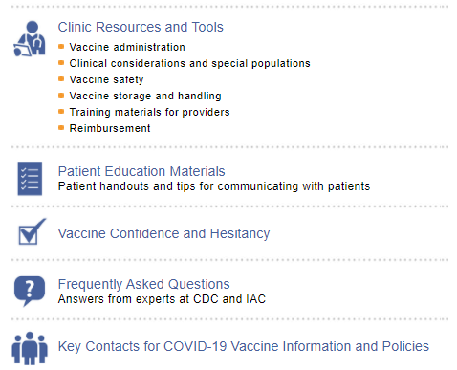
https://www.immunize.org/

Slide 41
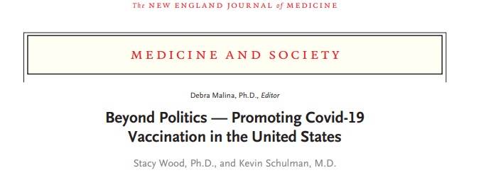
https://www.nejm.org/doi/pdf/10.1056/NEJMms2033790?articleTools=true

Slide 42
Thank you!

